Slide 1
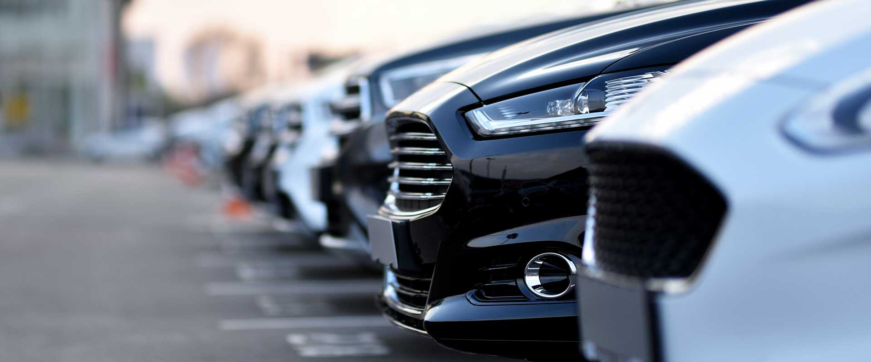
CAR RENTAL SYSTEM

Slide 2

ABSTRACT
The Car Rental System is designed to simplify the process of renting cars for customers and managing vehicles for rental companies. It allows customers to register, view available cars, book rentals, and make payments easily. The system also helps administrators keep track of customers, cars, rentals, and payments efficiently. By automating these tasks, the system saves time, reduces errors, and provides a smooth car booking experience.

Slide 3
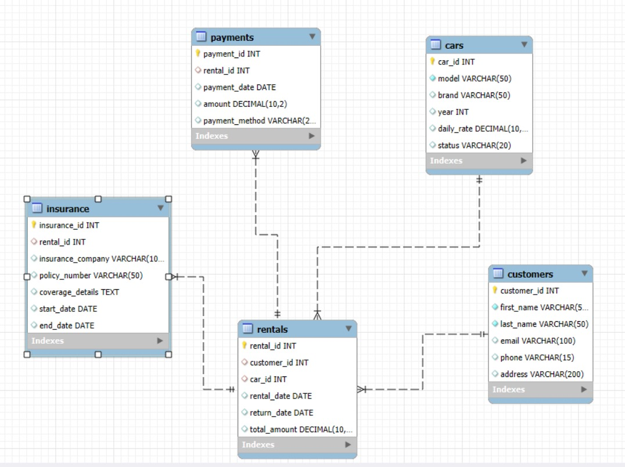
ER DAIGRAM

Slide 4
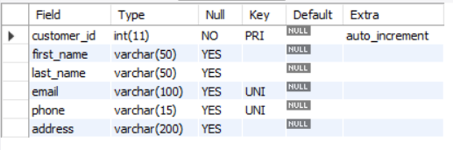
STRUCTURE OF TABLE
Customer Table
Customer Table → Stores customer details who rent cars.
CREATE TABLE Customers (
        customer_id INT PRIMARY KEY,
first_name VARCHAR(50),
last_name VARCHAR(50),
email VARCHAR(100) UNIQUE,
phone VARCHAR(15) UNIQUE,
address VARCHAR(200));

Slide 5
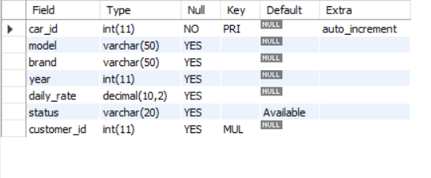
Cars Table
Cars Table → Keeps records of all cars and their availability.
CREATE TABLE Cars ( car_id INT PRIMARY KEY AUTO_INCREMENT,
model VARCHAR(50),
brand VARCHAR(50),
year INT,
daily_rate DECIMAL(10,2), status VARCHAR(20) DEFAULT 'Available',
customer_id INT, FOREIGN KEY (customer_id) REFERENCES Customers(customer_id) -- link to Customers);

Slide 6
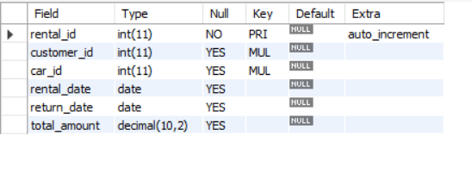
Rentals Table
Rentals Table → Tracks which customer rented which car and for how long.
CREATE TABLE Rentals ( rental_id INT PRIMARY KEY AUTO_INCREMENT,
customer_id INT,
car_id INT,
rental_date DATE,
return_date DATE,
total_amount DECIMAL(10,2), FOREIGN KEY (customer_id) REFERENCES Customers(customer_id), FOREIGN KEY (car_id) REFERENCES Cars(car_id));

Slide 7
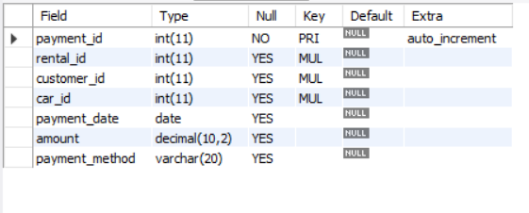
Payment Table
Payments Table → Manages payment details for each rental.
CREATE TABLE Payments ( payment_id INT PRIMARY KEY AUTO_INCREMENT,
rental_id INT,
customer_id INT,
car_id INT,
payment_date DATE,
amount DECIMAL(10,2),
payment_method VARCHAR(20),
FOREIGN KEY (rental_id) REFERENCES Rentals(rental_id),
FOREIGN KEY (customer_id) REFERENCES Customers(customer_id),
FOREIGN KEY (car_id) REFERENCES Cars(car_id));

Slide 8
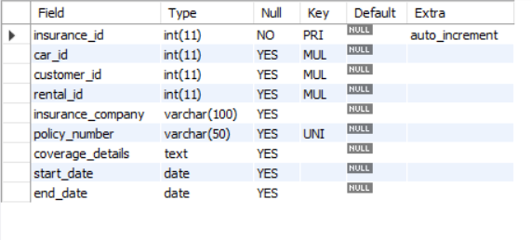
Insurance Table
Insurance Table → Stores insurance details linking cars, customers, and rentals.
CREATE TABLE Payments ( payment_id INT PRIMARY KEY AUTO_INCREMENT,
rental_id INT,
customer_id INT,
car_id INT,
payment_date DATE,
amount DECIMAL(10,2),
payment_method VARCHAR(20),
FOREIGN KEY (rental_id) REFERENCES Rentals(rental_id),
FOREIGN KEY (customer_id) REFERENCES Customers(customer_id),
FOREIGN KEY (car_id) REFERENCES Cars(car_id));

Slide 9
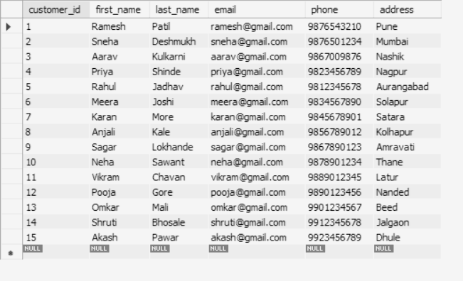
CONTENTS OF TABLE
Customer Table

Slide 10
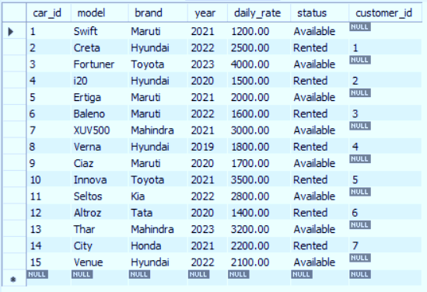
CONTENTS OF TABLE
Cars Table

Slide 11
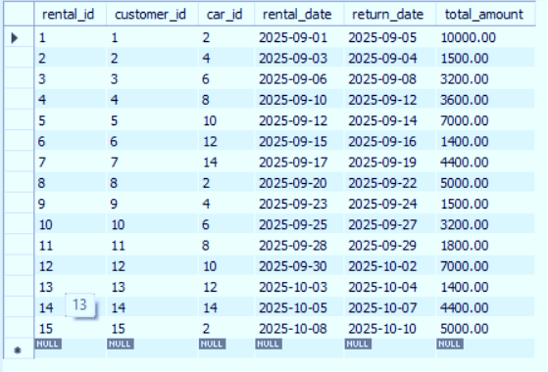
Rentals Table

Slide 12
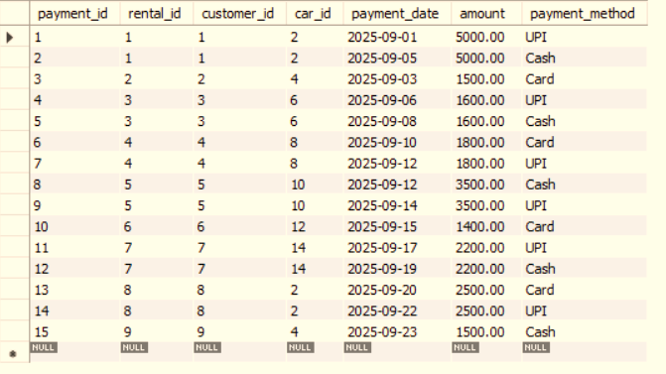
Payments Table

Slide 13
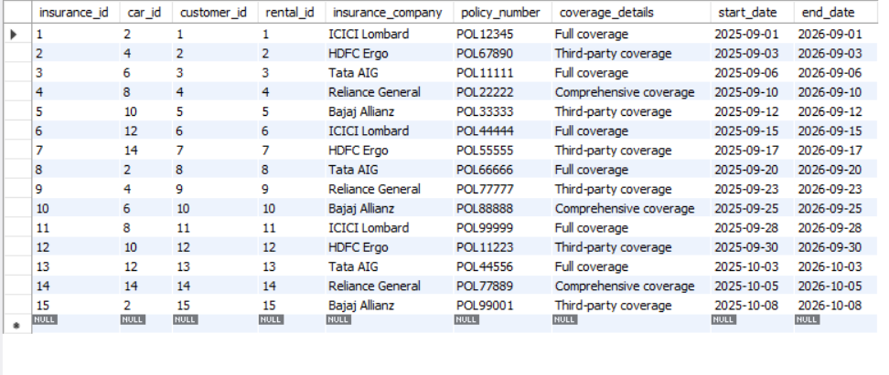
InsuranceTable

Slide 14
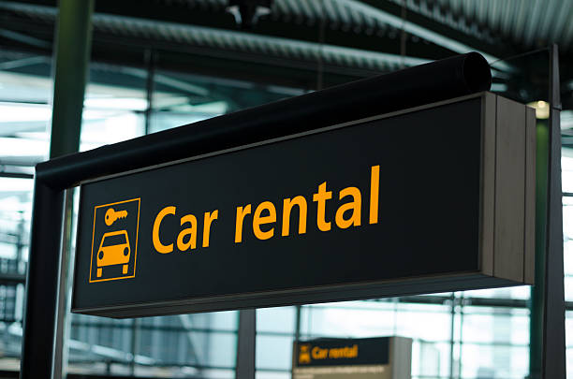
SUB QUERIES

Slide 15
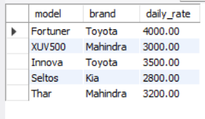
SUB QUERIES
Write a Query to Find daily_rate of cars higher than the daily_rate of car_id = 2
SELECT model, brand, daily_rate
FROM CarsWHERE daily_rate >
(SELECT daily_rate FROM Cars WHERE car_id = 2);

Slide 16
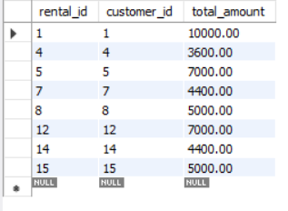
SUB QUERIES
Write a query to find all rentals whose total_amount is greater than the rental with rental_id = 3.
SELECT rental_id, customer_id, total_amount
FROM Rentals
WHERE total_amount > (SELECT total_amount FROM Rentals WHERE rental_id = 3);

Slide 17
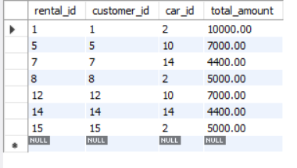
SUB QUERIES
Write a query to find all rentals whose total_amount is greater than the average total_amount of all rentals.
SELECT rental_id, customer_id, car_id, total_amount
FROM Rentals
WHERE total_amount >
(SELECT AVG(total_amount) FROM Rentals);

Slide 18
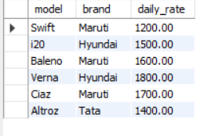
SUB QUERIES
Write a query to find all cars whose daily_rate is less than the average daily_rate of Hyundai cars.
SELECT model, brand, daily_rate
FROM Cars
WHERE daily_rate < (
SELECT AVG(daily_rate) FROM Cars
WHERE brand = 'Hyundai');

Slide 19
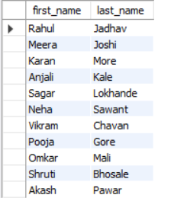
SUB QUERIES
Write a query to find all customers who have rented a car after ‘2025-09-10’.
SELECT first_name, last_name
FROM Customers
WHERE customer_id IN (
SELECT customer_id
FROM Rentals
WHERE rental_date > '2025-09-10'
);

Slide 20
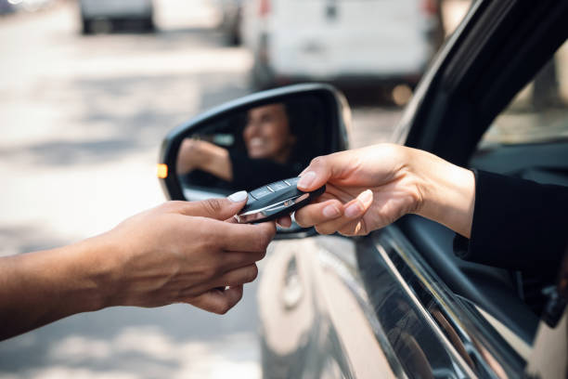
JOINS

Slide 21
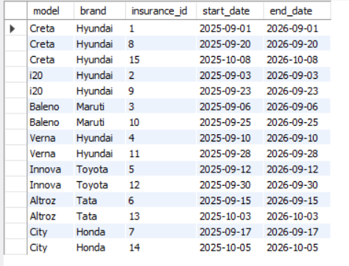
JOINS
Write a query to display cars with their insurance information.
SELECT car.model, car.brand, i.insurance_id, i.start_date, i.end_date
FROM Cars car
INNER JOIN Insurance i ON car.car_id = i.car_id;

Slide 22
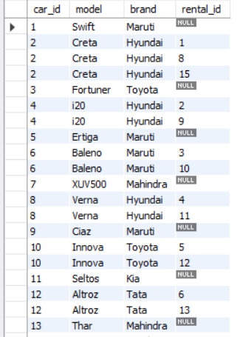
JOINS
Write a query to list all cars and their rentals, including cars not rented at all.
SELECT car.car_id, car.model, car.brand, r.rental_id
FROM Cars car
LEFT JOIN Rentals r ON car.car_id = r.car_id;

Slide 23
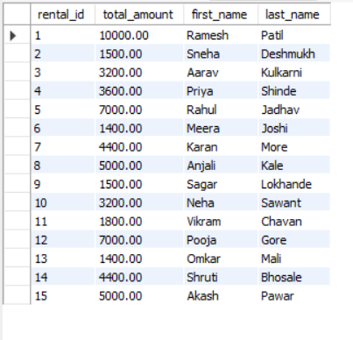
JOINS
Write a query to display all rentals with their customers. Show all rentals even if customer details are missing.
SELECT r.rental_id, r.total_amount, c.first_name, c.last_name
FROM Customers c
RIGHT JOIN Rentals r ON c.customer_id = r.customer_id;

Slide 24
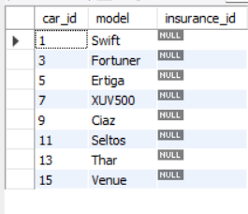
JOINS
Write a query to find cars that do not have insurance.
SELECT car.car_id, car.model, i.insurance_id
FROM Cars car
LEFT JOIN Insurance i ON car.car_id = i.car_id
WHERE i.insurance_id IS NULL;

Slide 25
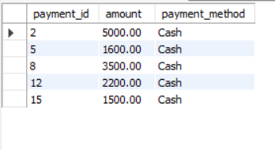
JOINS
Write a query to display all the payments that were made either by Cash or by Credit Card. Use the UNION operator to combine the results
SELECT payment_id, amount, payment_method FROM Payments WHERE payment_method = 'Cash'UNIONSELECT payment_id, amount, payment_method FROM Payments WHERE payment_method = 'Credit Card';

Slide 26

VIEWS

Slide 27
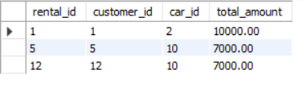
VIEWS
Create a view to show rentals where the total amount is greater than 5000.
CREATE VIEW High_Value_Rentals ASSELECT rental_id, customer_id, car_id, total_amountFROM RentalsWHERE total_amount > 5000;

Slide 28
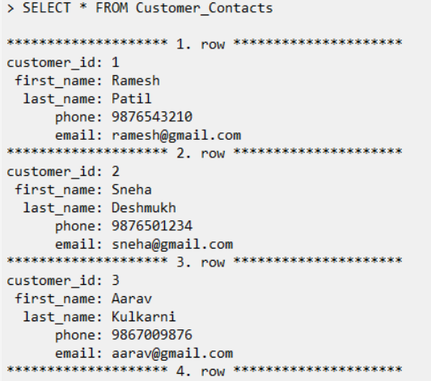
VIEWS
Create a view to quickly see all customers with their phone numbers and emails
CREATE VIEW Customer_Contacts ASSELECT customer_id, first_name, last_name, phone, emailFROM Customers;

Slide 29
THANK YOU

